Slide 1
CUSTOMER RELATIONSHIP MANAGEMENT SYSTEM [CRM]
Guided By Presented By smt.Betty James Jyothi R

Slide 2
INTRODUCTION
The goals of CRM are generally to create a better customer experience & because of customer experience , to get more sails. That’s why it’s called CRM.
Customer Relationship management concept and its impact on customer loyalty is gaining more and more attention in present business world.
Companies are focusing on retaining their loyal customers rather than gaining new.

Slide 3
PROBLEM STATEMENT
To develop an online feedback management system for vehicles that allows admin to submit complaints , queries or issues related by public.

Slide 4
EXISTING SYSTEM
Marketing strategies may not be personalized based on specific customer feedback.
Inadequate attention to customer feedback may result in unresolved issues
Decreased customer satisfaction.
There is a chance to forget user complaints.
potential loss of business.

Slide 5
PROPOSED SYSTEM
Improving business efficiency
Improving customer satisfaction
Enhancing your sales and supporting teams
Expanding your customer base
Building long-term relationships

Slide 6
MODULES
ADMIN ONLY:
Can create an account for organization and approve the organization allowed users to get into the website.

Slide 7
SYSTEM SPECIFICATION
Front-end: HTML CSS, Java script
HTML,CSS and Java script are fundamental technologies used for building and designing web pages.
Back-end: Laravel(PHP Framework)
Laravel is used to create websites with MVC(model-view-controller) patterns.

Slide 8
DATA FLOW DIAGRAM
Level0
Customer management
Offering management
Customer relationship management system
Customer feedback management
Transaction management
Salesman management
Product management

Slide 9
level1
Customer management
Generate customer report
Customer feedback management
Generate customer feedback report
CRM
Salesman management
Generate salesman report
Product management
Generate product report
Transaction management
Check transaction details
Offering management
Generate offering report

Slide 10
ENTITY-RELATIONSHIP DIAGRAM

Slide 11
Service_ amt
Customer _address
Service name
customer_
id
Customer contact
Service_ no
Customer_ name
get
customer
service
customer _type
Contact_
no
Admin _ id
Admin _ role
Website_
Name
create
manage
CRM
Admin
Admin_ name
Website _ url

Slide 12
USECASE DIAGRAM

Slide 13
Login
Input customer data
Add customer
Admin
Update customer details
user
Delete Employee
feedback
Logout

Slide 14
SCREENSHOTS

Slide 15
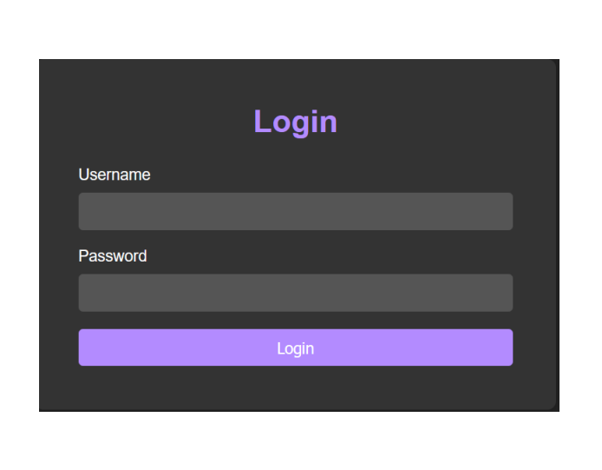

Slide 16
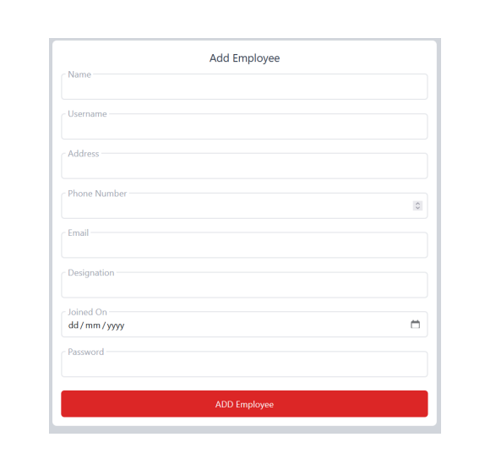

Slide 17
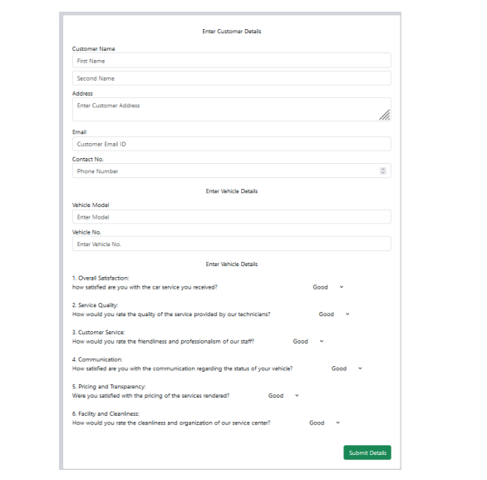

Slide 18
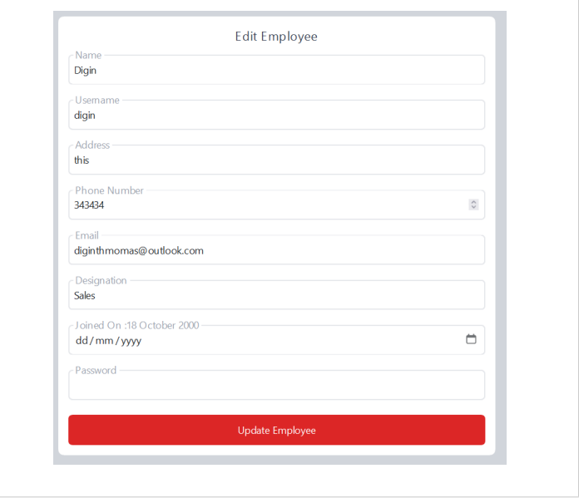

Slide 19
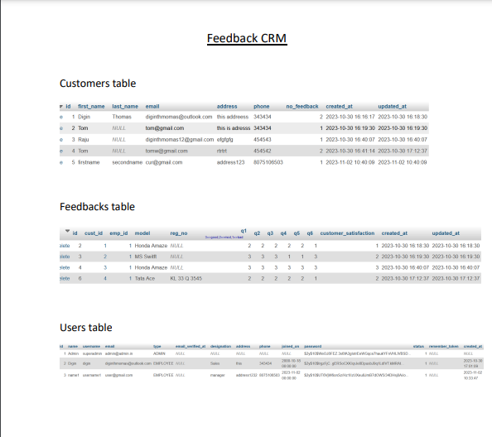

Slide 20
CONCLUSION
One of the main benefits of a CRM system is that it smoothens the customer retention process and leads to more returning customers, which is always a sign of a healthy and productive company.
The collected feedback is used to identify issues and positive aspects of the organization and make informed decisions about the employees and the organization as a whole.

Slide 21
REFERENCE
https://www.techtarget.com
https://www.researchgate.net
https://www.scribd.com
https://github.com-customer-relationship-management

Slide 22
THANKYOU…

